Slide 1
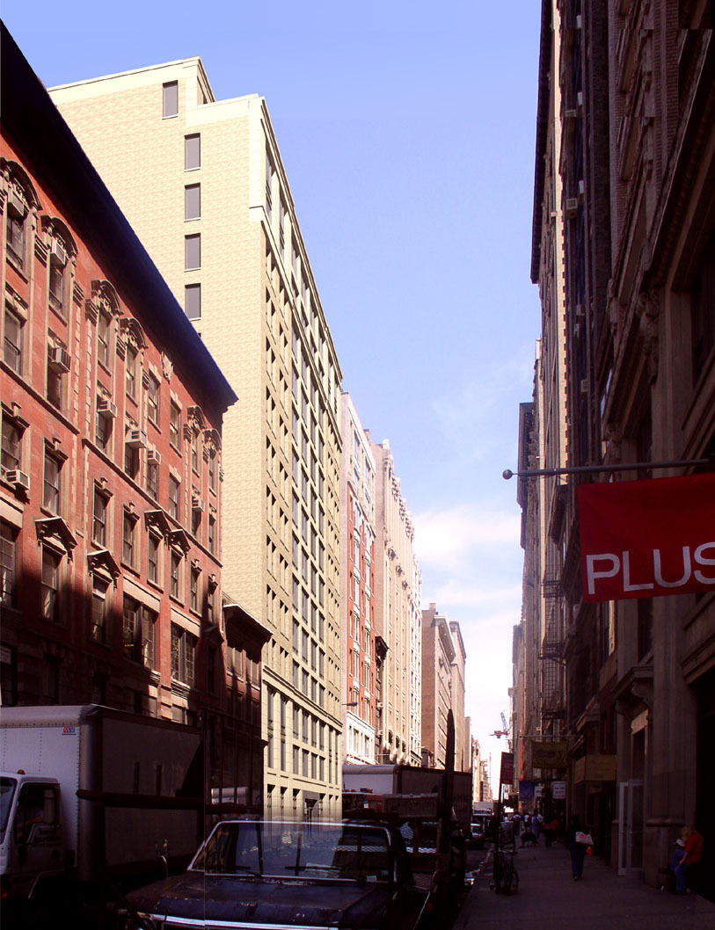
Dan Donecker
BAE/MAE – Structural Option
Senior Thesis Project
35 West 21st Street
New York, New York

Slide 2
Presentation Outline
Building Introduction
Existing Conditions
Thesis Proposal
Structural Redesign: Gravity
Structural Redesign: Lateral
Breadth Redesign: Architecture
Comparison of Existing and Redesigned Building
Questions
35 West 21st Street
Dan Donecker – Structural Option

Slide 3
Existing Conditions
- General
Location: 35w 21st Street, NY, NY
16 Stories – 160 ft above grade
162,000 sq. ft
Occupancy:
  First floor Retail
  Stories 2-15, Residential
Owner: Roseland Associates
Architect: SLCEArchitects
Struct. Engr.: DeSimone Consulting Engineers
Mech. Engr.: Cosentini Associates
CM: Plaza Construction Corporation
35 West 21st Street
Dan Donecker – Structural Option

Slide 4
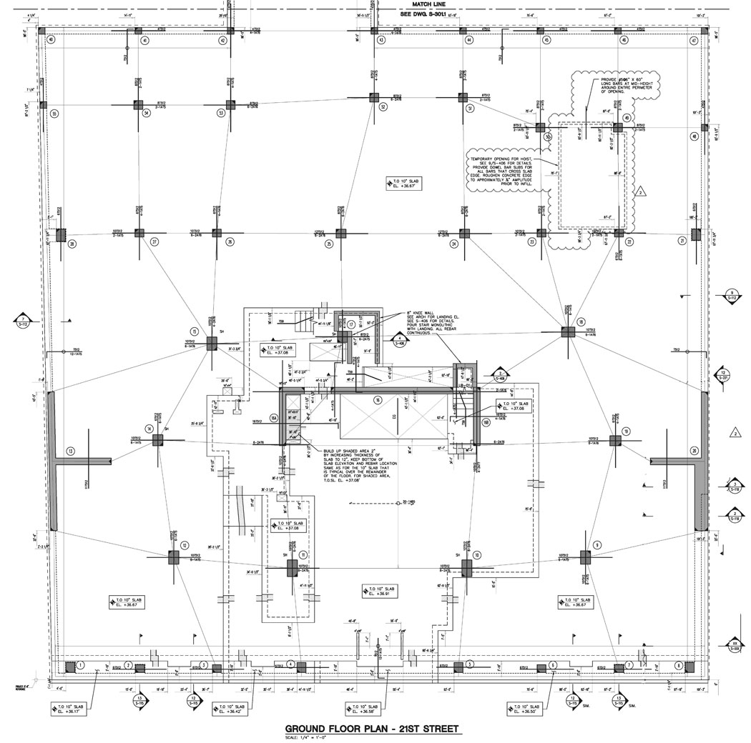
Existing Conditions
- Architecture
Building composed of two sections
  16 story tower (blue)
  8 story tower (green)
N
35 West 21st Street
Dan Donecker – Structural Option

Slide 5
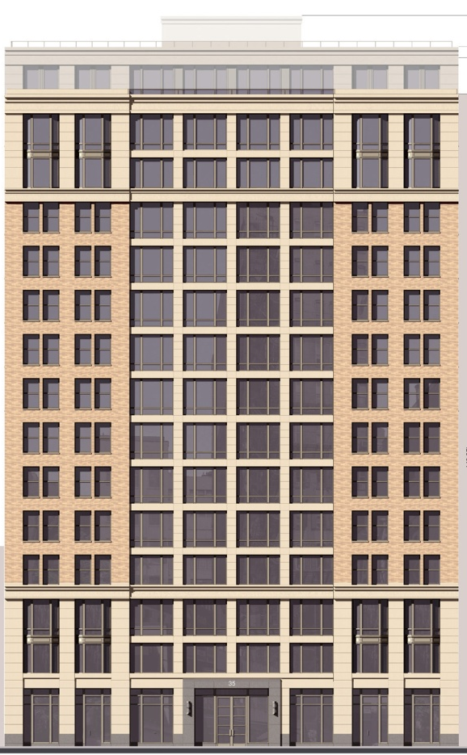
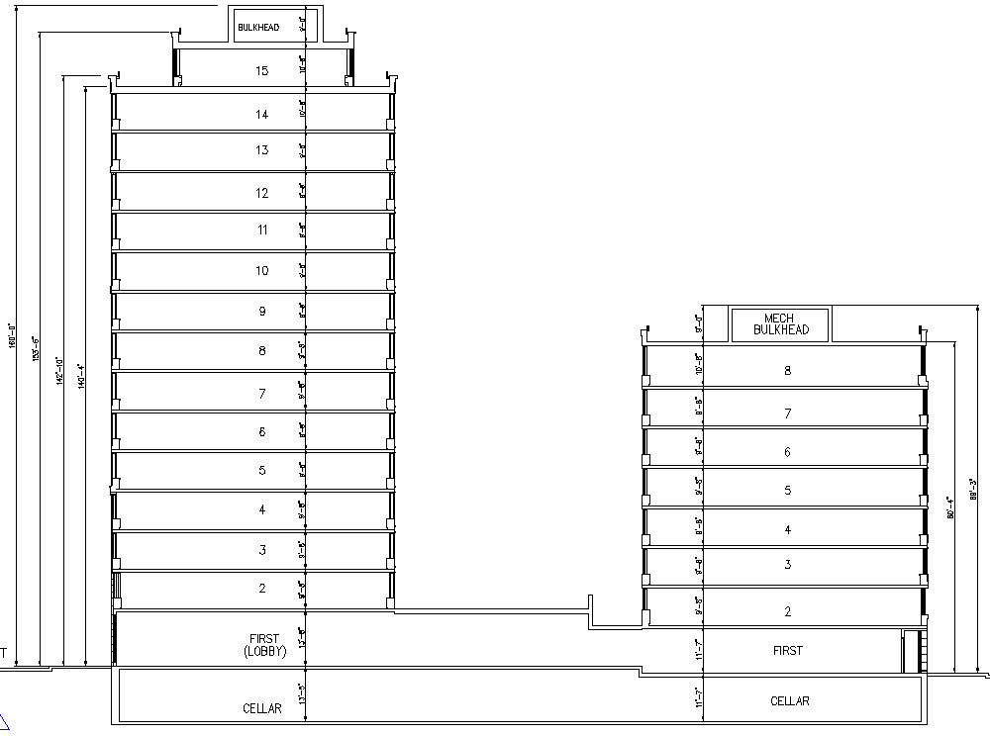
Existing Conditions
Architecture
Towers connected at Two levels
Classic stone façade
35 West 21st Street
Dan Donecker – Structural Option

Slide 6
Existing Conditions
Structural: floor
Two – way flat plate
  8” thick (typ.)
  5 ksi concrete
  Studrails at
  columns with
  high shear
N
35 West 21st Street
Dan Donecker – Structural Option

Slide 7
Existing Conditions
Structural: Columns
Rectangular Col.
  No typical size
  No typical spacing
  Position governed
  by architecture
  5.95 ksi concrete
  Studrails in areas
  of high shear
N
35 West 21st Street
Dan Donecker – Structural Option

Slide 8
Existing Conditions
Structural: Lateral system
Shear wall system
  5.95 ksi concrete
  Position governed
  by architecture
N
35 West 21st Street
Dan Donecker – Structural Option

Slide 9
Thesis Proposal
Summary
Create regular column grid
Minimize floor thickness
Optimize lateral system
Integrate architecture and structural
Remove ceiling cavity
35 West 21st Street
Dan Donecker – Structural Option

Slide 10
Thesis Proposal
Goals
The ultimate goal of this thesis is to minimize the floor-to-floor height of each story in order to add an extra floor without increasing the overall building height. Also to increase constructability by providing a regular column grid and typical column sizes
35 West 21st Street
Dan Donecker – Structural Option

Slide 11
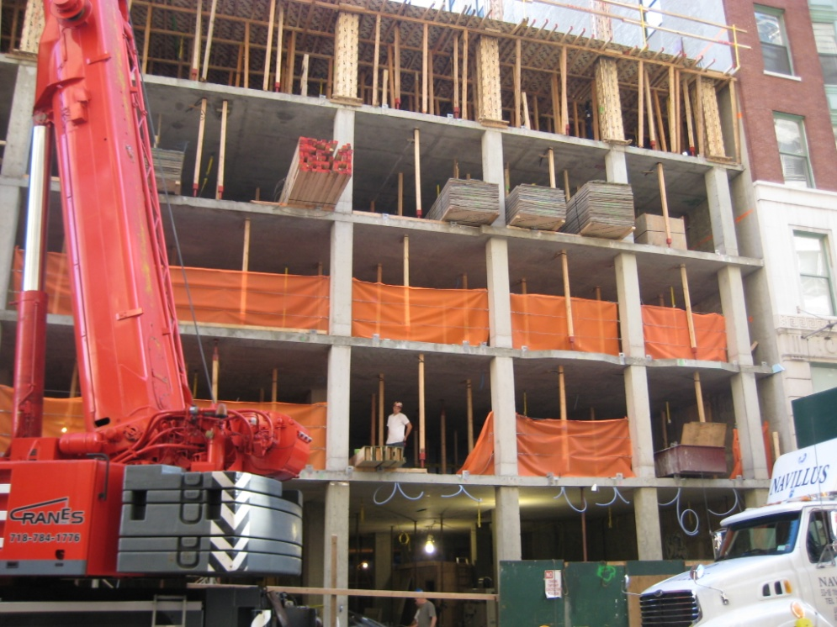
Structural Redesign:
- Gravity Columns
Create Regular Column Grid
Design Columns Per New Grid
35 West 21st Street
Dan Donecker – Structural Option

Slide 12
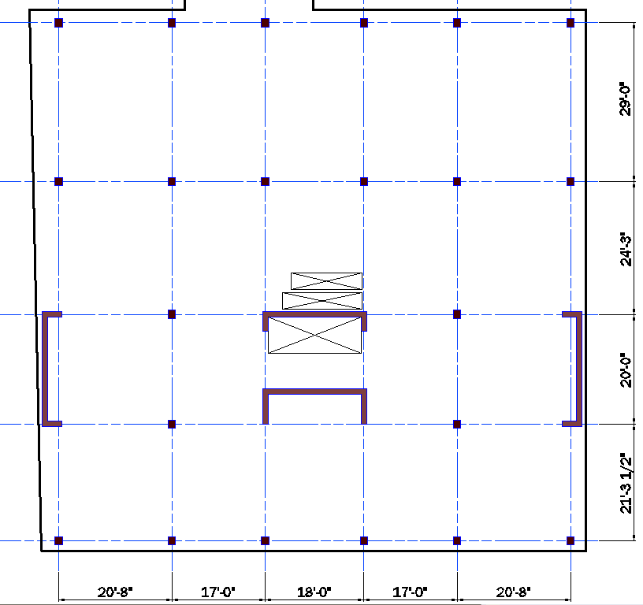
Structural Redesign:
- Gravity Columns
N
Existing column layout
Revised column layout
35 West 21st Street
Dan Donecker – Structural Option

Slide 13
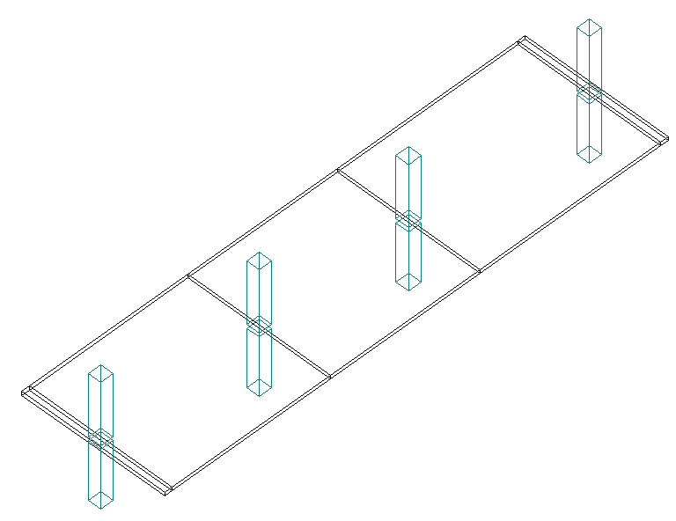
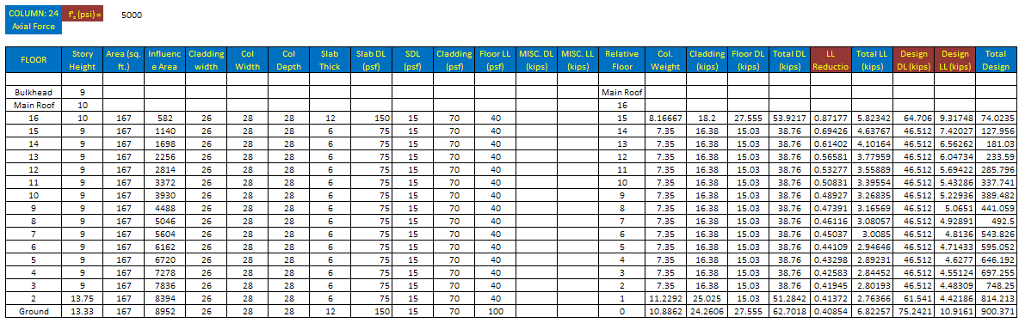
Structural Redesign:
Gravity Columns
Column load take down
spreadsheet
PCA Slab for moments
35 West 21st Street
Dan Donecker – Structural Option

Slide 14
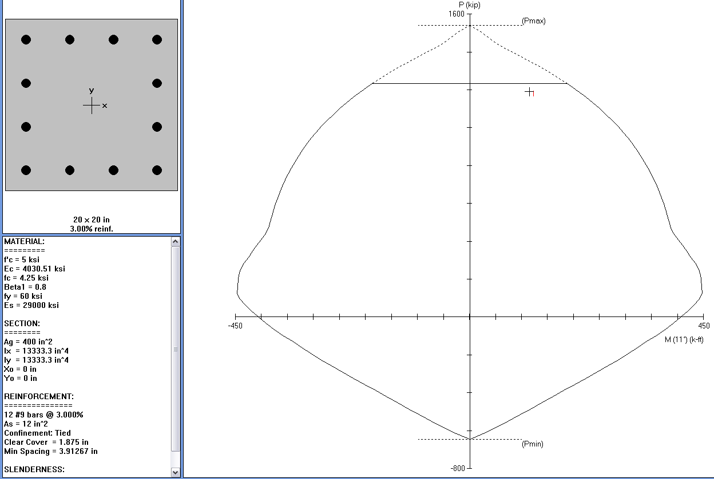
Structural Redesign:
Gravity Columns
PCA Column used to design gravity columns
for biaxial bending and compression
35 West 21st Street
Dan Donecker – Structural Option

Slide 15
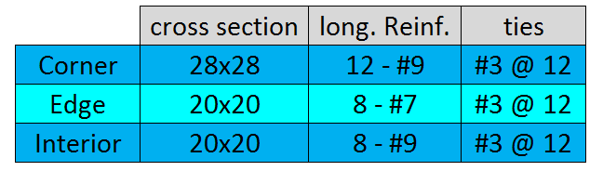
Structural Redesign:
Gravity Columns
Number of columns reduced
  Existing – 31
  Redesign – 16
Number of different cross sections
  Existing – 14
  Redesign – 3
35 West 21st Street
Dan Donecker – Structural Option

Slide 16
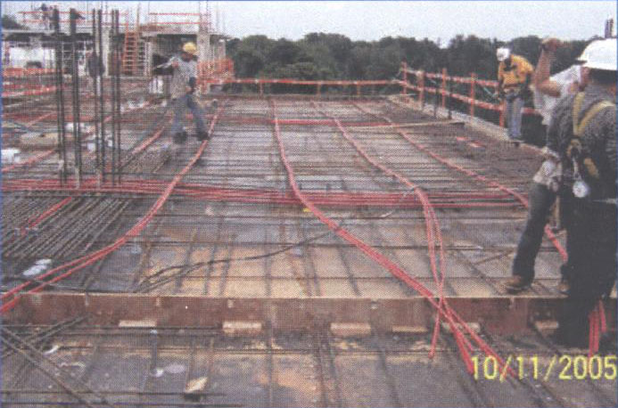
Structural Redesign:
- Gravity Floor
Post-Tension 2-way Flat Plate
  Reduce Floor Thickness
  Add Another Level?
Picture from Holbert Apple Associates, Inc.
35 West 21st Street
Dan Donecker – Structural Option

Slide 17
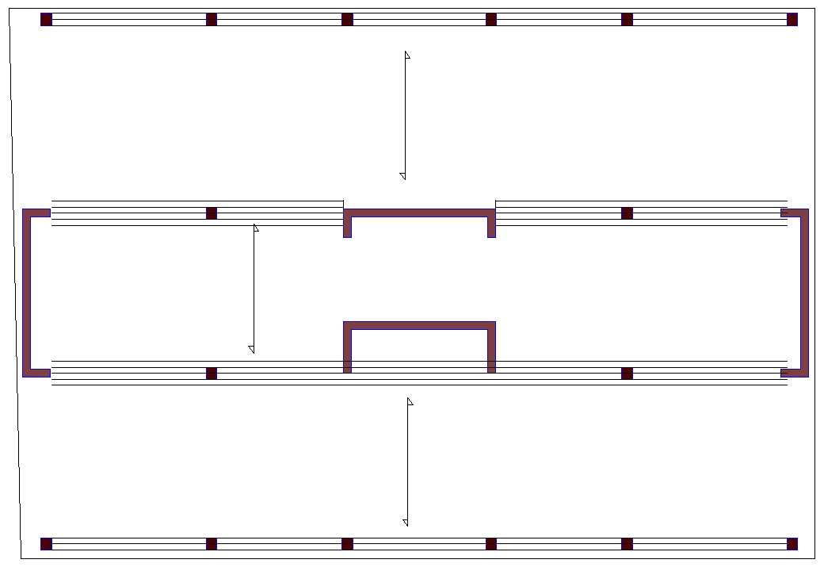
Structural Redesign:
- Gravity Floor
Post-Tension 2-way Flat Plate
Per Chapter 13 & 18 of ACI 318-05
Frame 4
Frame 3
Frame 2
Frame 1
35 West 21st Street
Dan Donecker – Structural Option

Slide 18
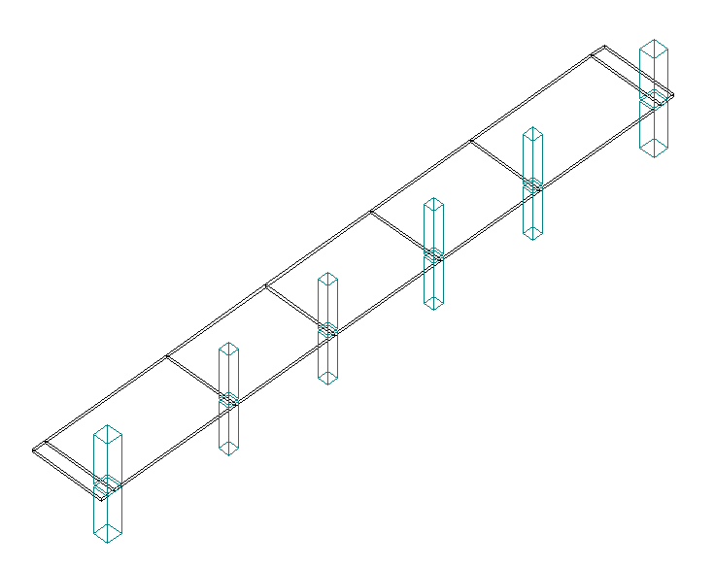
Structural Redesign:
- Gravity Floor
Post-Tension 2-way Flat Plate
PCA Slab used to determine moments and shears
FRAME 1
35 West 21st Street
Dan Donecker – Structural Option

Slide 19
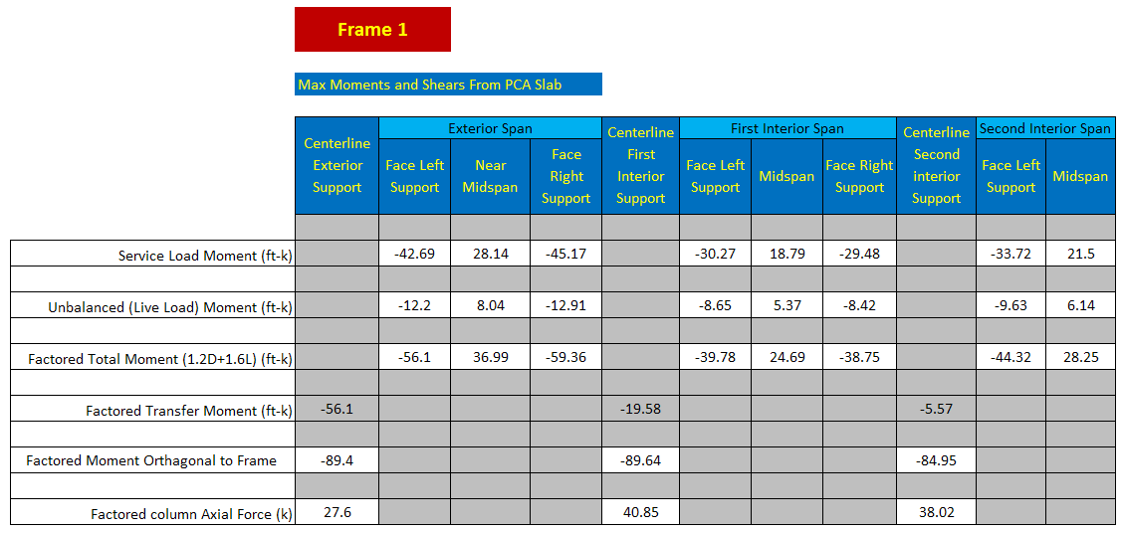
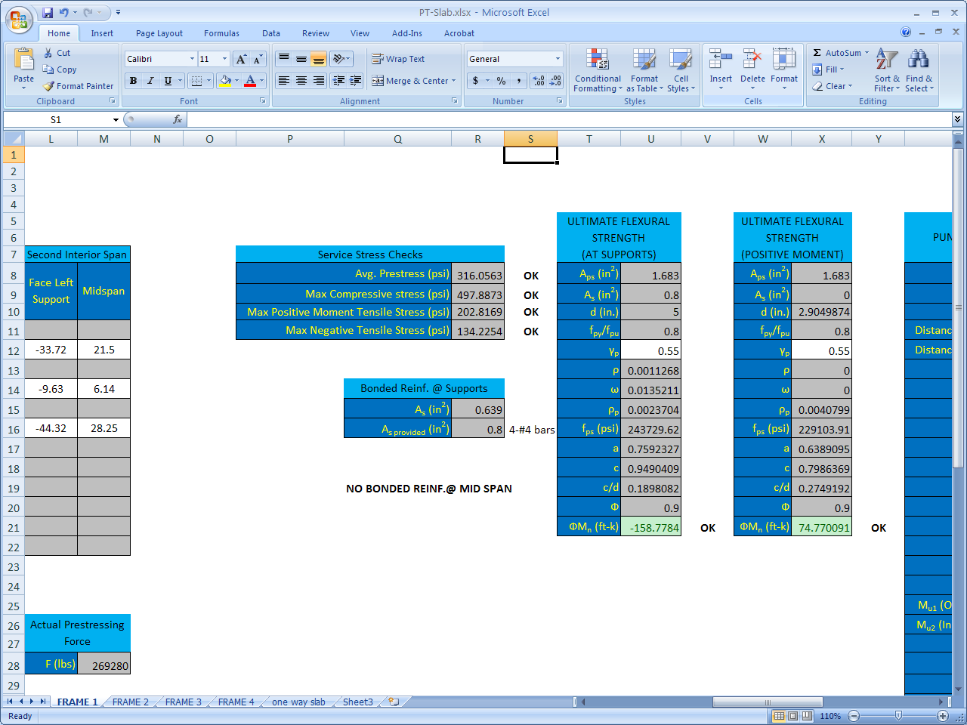
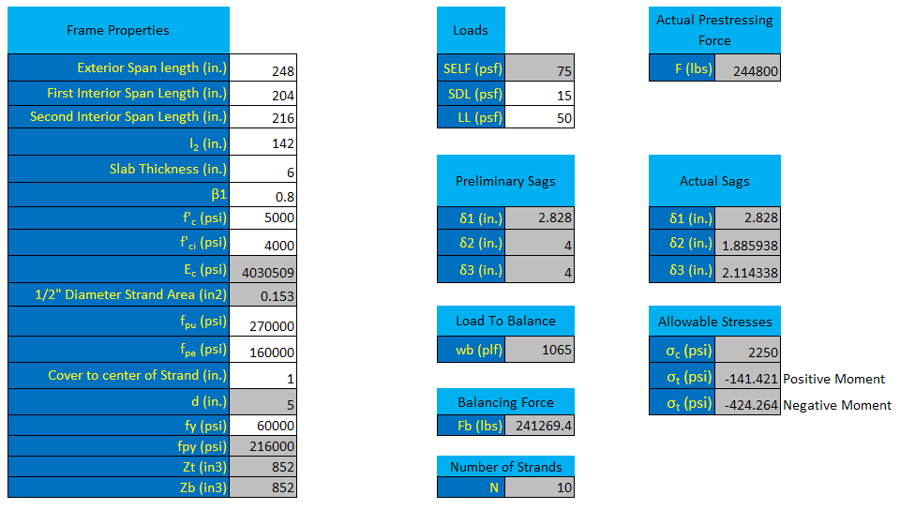
Structural Redesign:
- Gravity Floor
35 West 21st Street
Dan Donecker – Structural Option

Slide 20
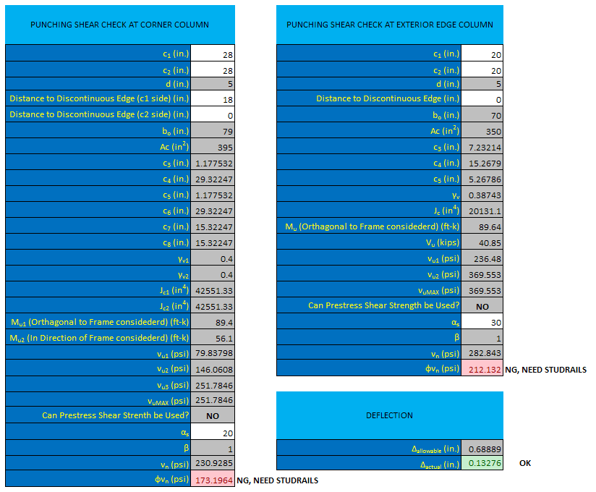
Structural Redesign:
- Gravity Floor
35 West 21st Street
Dan Donecker – Structural Option

Slide 21
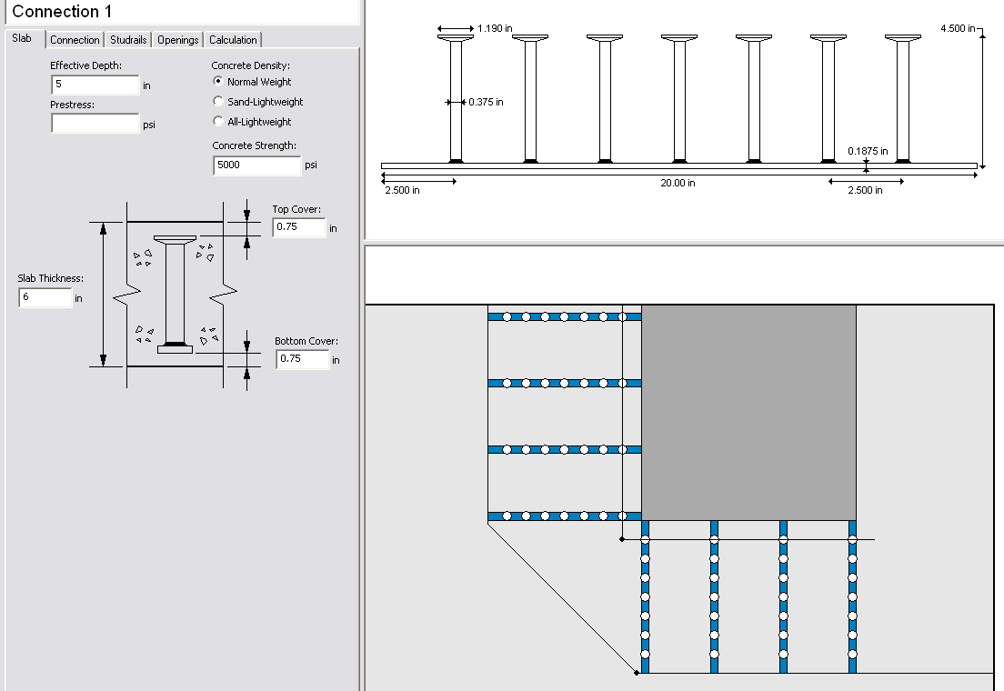
Structural Redesign:
Gravity Floor
Studrail Design
Decon Studrail design http://www.deconusa.com/
35 West 21st Street
Dan Donecker – Structural Option

Slide 22
Structural Redesign:
- Gravity Floor
10 – ½” Diam. Strands
20 – ½” Diam.
Strands
20 – ½” Diam.
Strands
1 – ½” Diam.
Strand @ 12 (typ.)
10 – ½” Diam. Strands
35 West 21st Street
Dan Donecker – Structural Option

Slide 23
Structural Redesign:
Gravity Floor
Existing floor thickness – 8”
Redesigned floor thickness – 6”
Additional 26” of height available
Decreased cu. Yd. of Concrete needed
Increased difficulty of construction
35 West 21st Street
Dan Donecker – Structural Option

Slide 24
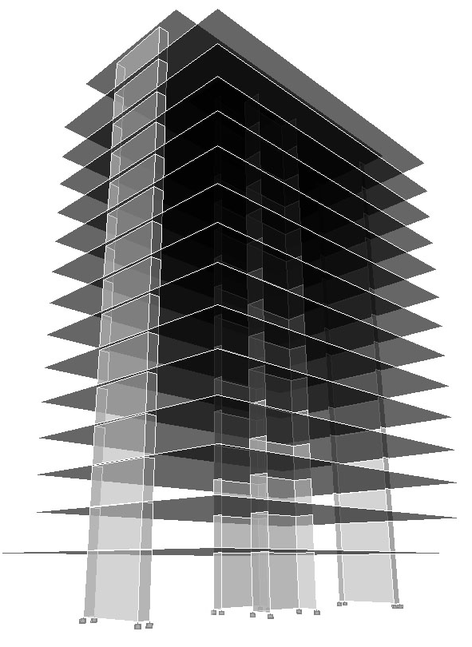
Structural Redesign:
- Lateral
Optimize Shear Walls
  Integrate into new
  grid and arch.
  Do not decrease
  performance
35 West 21st Street
Dan Donecker – Structural Option

Slide 25
Structural Redesign:
- Lateral
Existing shear wall plan
Redesigned shear wall plan
N
35 West 21st Street
Dan Donecker – Structural Option

Slide 26
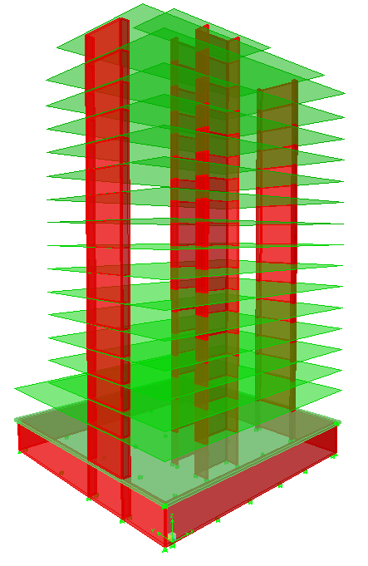
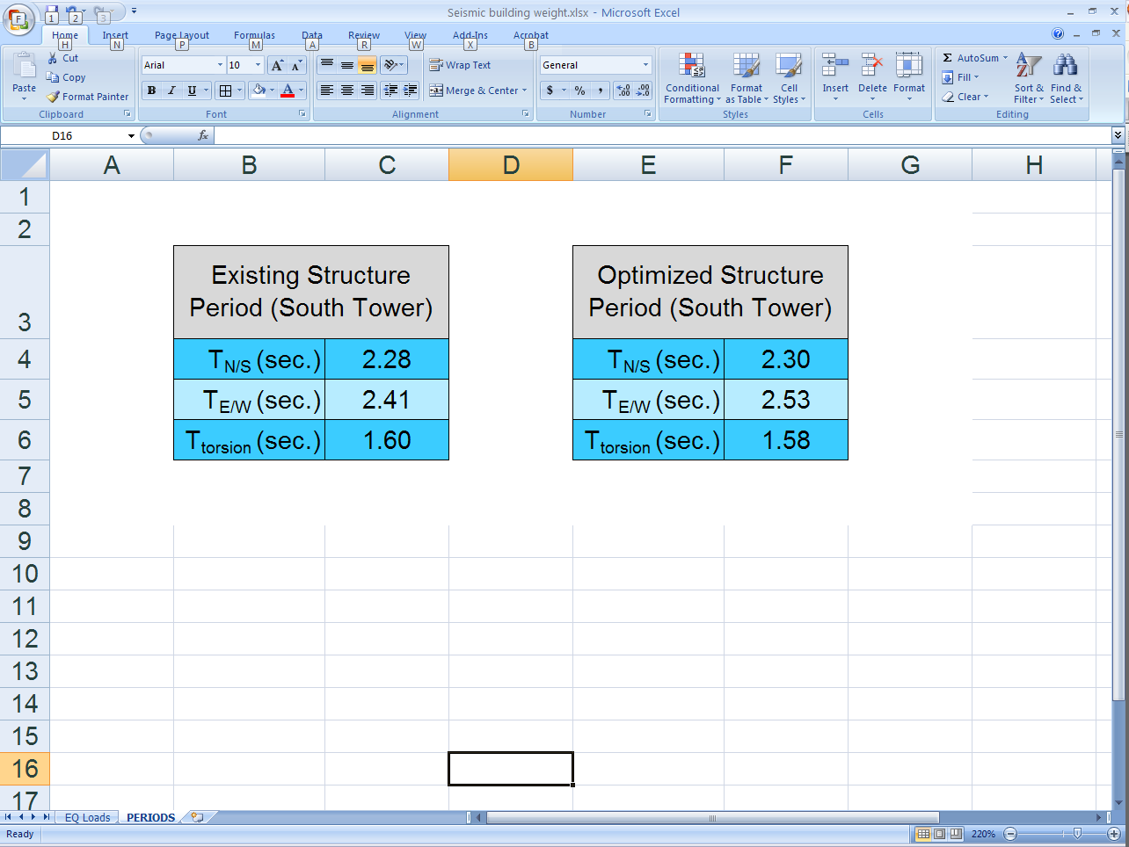
Structural Redesign:
- Lateral
Performance not decreased
by new plan
35 West 21st Street
Dan Donecker – Structural Option

Slide 27
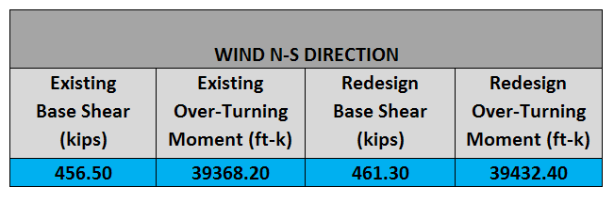
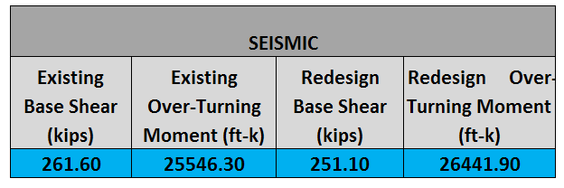
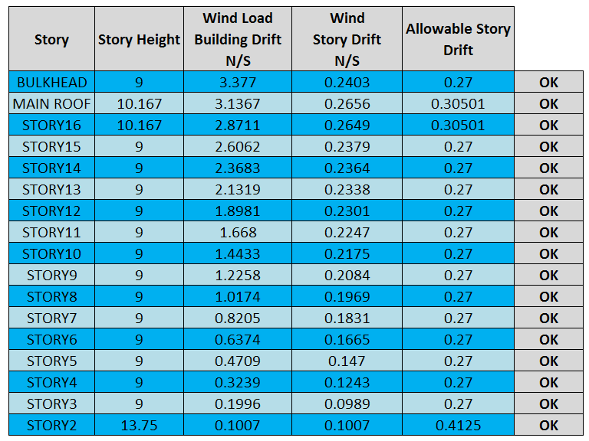
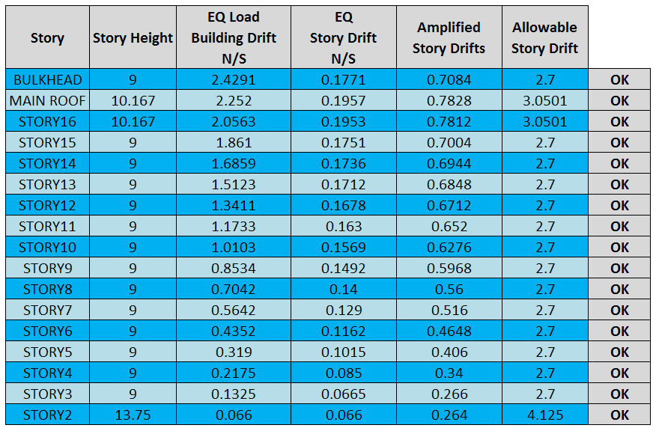
Structural Redesign:
Lateral – loads/drifts
Wind – ASCE 7-05 CH. 6
Seismic – ASCE 7-05 CH. 11 & 12
% Diff. wind = 1.1 %
% Diff. seismic = 3.8 %
35 West 21st Street
Dan Donecker – Structural Option

Slide 28
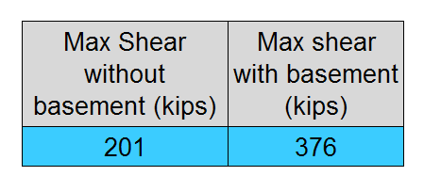
Structural Redesign:
Lateral – Shear wall design
Explicit modeling of basement walls and ground floor diaphragm
  Large increase in maximum shear wall force
  Shear reversal
  87% increase
35 West 21st Street
Dan Donecker – Structural Option

Slide 29
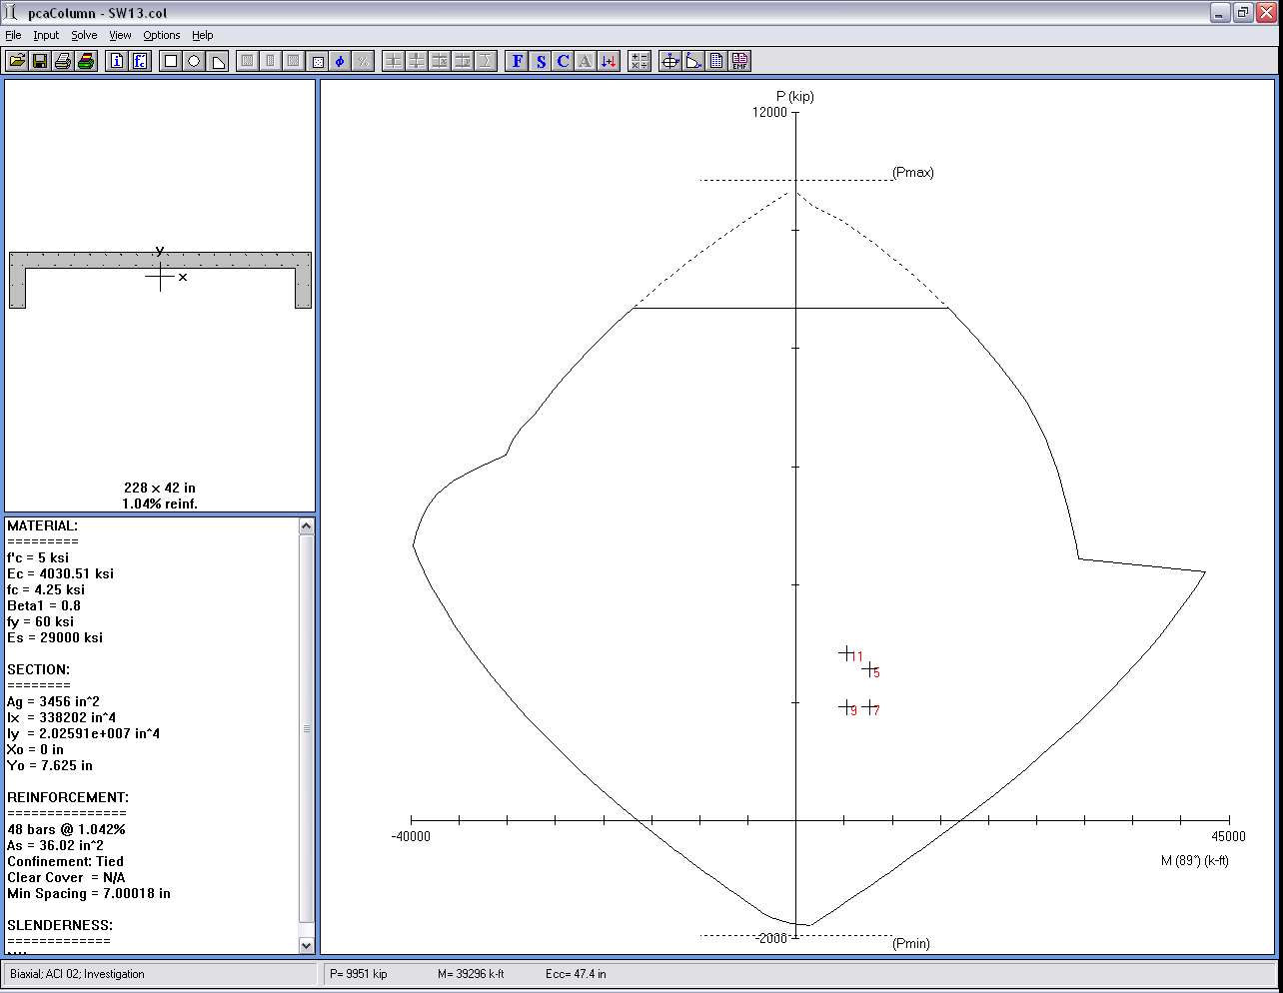
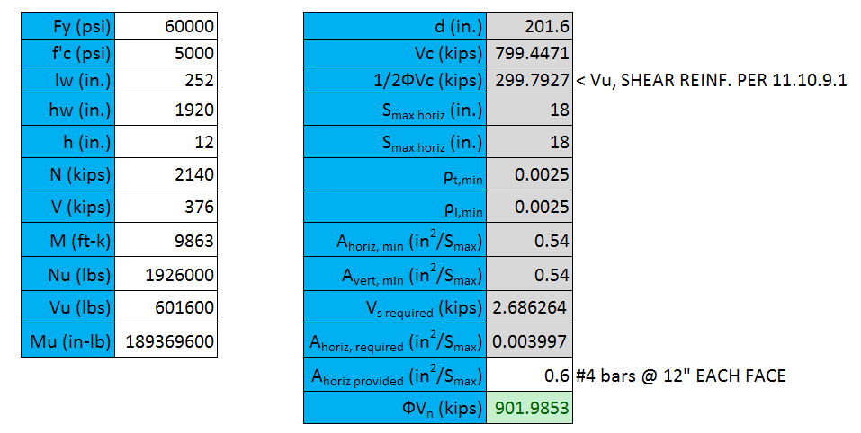
Structural Redesign:
Lateral – Shear wall design
Reinforcement governed By Minimum per
ACI 318-05 Chapters 10, 11 & 14
Chapter 21 need not be considered
  Ordinary reinforced conc. Shear wall
35 West 21st Street
Dan Donecker – Structural Option

Slide 30
Structural Redesign:
Lateral – Shear construction
No link beams in new design
Existing cu. Yd of Conc. = 575
Redesign Cu. Yd of Conc. = 628
9.2% increase
Attribute needed increase in concrete to explicit modeling of basement and ground floor diaphragm
35 West 21st Street
Dan Donecker – Structural Option

Slide 31
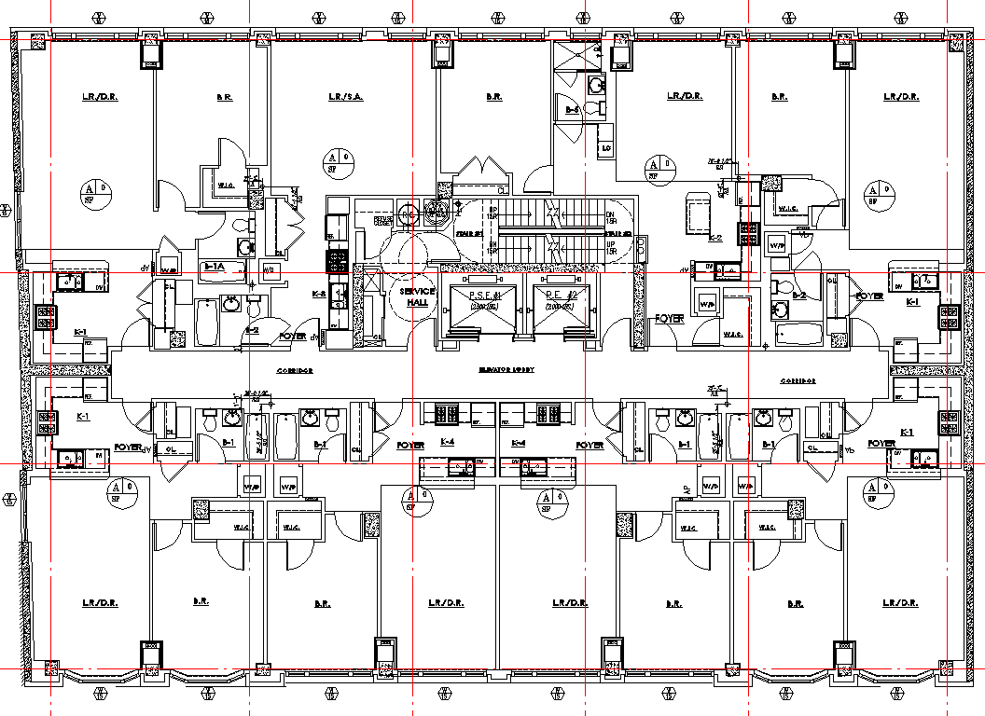
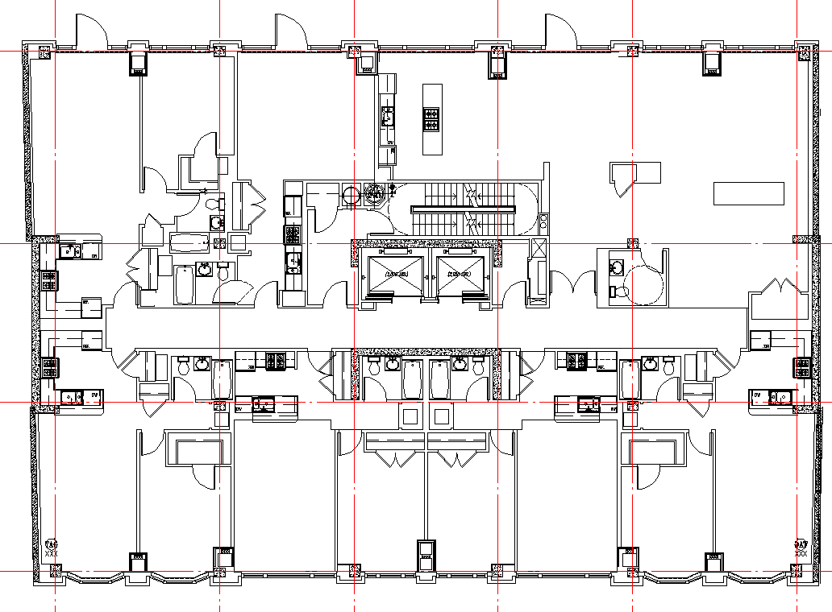
Architectural Breadth:
Floor Plans
Integrate structural grid and new shear wall plan with architecture
Existing Arch. Floor Plan
Redesigned Arch. Floor Plan
35 West 21st Street
Dan Donecker – Structural Option

Slide 32
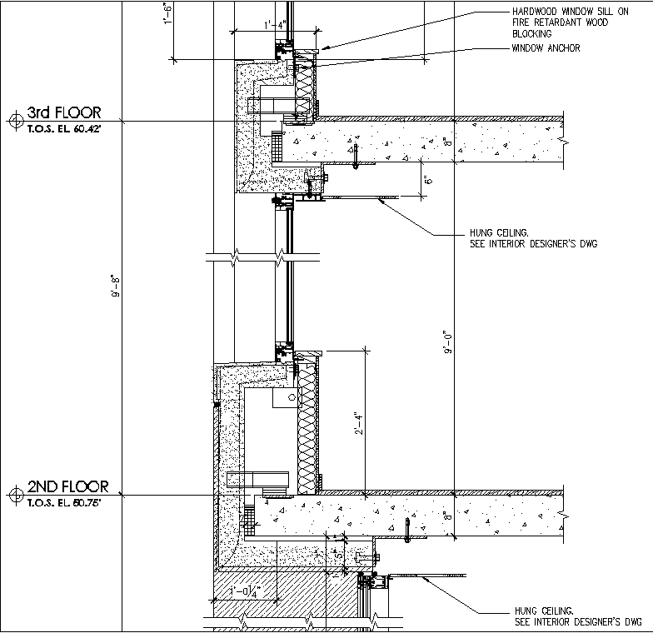
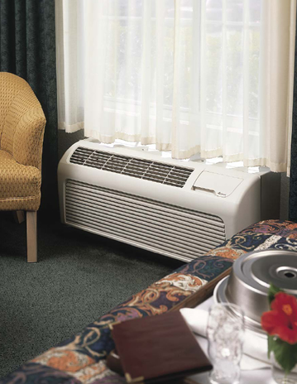
Mechanical Breadth:
Individual Heat Pumps
Remove ceiling cavity
Replace mechanical
ductwork with
Individual Air-to-Air
Heat pumps for each
apartment unit
35 West 21st Street
Dan Donecker – Structural Option

Slide 33
Conclusions:
Reduced slab thickness of 2”
Reduced ceiling cavity of 6”
Total reduction in height of 9’-6”
  Allows for additional story
Additional story has little effect on wind and seismic resisting elements as well as foundations
Decreased cost of construction for columns
Additional revenue from extra story outweighs the upfront costs of a post-tensioned slab.
Overall, Redesign is recommended
35 West 21st Street
Dan Donecker – Structural Option

Slide 34
Acknowledgements:
DeSimone Consulting
Engineers – Ben Downing
and Josh Gerard
All of the AE Faculty
  Especially :
  Professor Parfitt
  Dr. Lepage
  Dr. Memari
Thesis Advisor:
  Dr. Boothby
35 West 21st Street
Dan Donecker – Structural Option

Slide 35
Questions?
35 West 21st Street
Dan Donecker – Structural Option

